Slide 1
Mojaloop 3PPI Enablement PI-18
3PPI team
Mojaloop PI-18 community event

Slide 2
Agenda
PI-17 overview for 3PPI
3PPI features status
API snippets
3PPI roadmap

Slide 3
3PPI PI-17 overview

Slide 4
PI-17 Contributors
Chetan Manjeshwar
Cian Brassil
Georgi Logodazhki
JJ Geewax
Kevin Leyow
Kuan Yen Heng
Lewis Daly
Michael Richards
Miguel de Barros
Nizam Anuar
Sam Kummary
Vijay Guthi

Slide 5
Background: Mojaloop 3PPI timeline
Mojaloop 3PPI Phase-1
Proof of Concept [PoC]
Mojaloop 3PPI Phase-3
Productionize
2020
2022 Q2
2021
2022 Q3
Mojaloop 3PPI Phase-2
MVP
Mojaloop 3PPI Phase-3
Productionize,Adoption

Slide 6
Background [PoC]: 3PPI phase-1 outcomes
Designs and scaffolding for 3PPI flows, demonstrable with mocked services
Define characteristics of 3PPIs and FSPs that support third-party (3p) functionality
Draft Open API definition v0.1 to support Account Linking, 3p transfers (including sub functions for authentication such as GET /authorizations), subject to the approval of the Mojaloop CCB.
Happy path PoC demonstration for 3p linking and transfers created with mocked services including those needed for account linking, transfers with CI/CD pipelines setup
Modify the Mojaloop SDK to support extensions for 3p functionality
A Mojaloop lab capable of demonstrating a 3p transfer between two DFSPs initiated by a 3PPI

Slide 7
Background [MVP]: 3PPI phase-2 outcomes
Full coverage of error scenarios in third-party focused flows (linking, transfers)
3P services & demos to match the 3p API draft v0.1
Introduce a "CONSENT" type to the Account
Lookup Service for determining which PISP / AuthService is responsible for a given Consent
Third-party scheme adapter to function for both FSPs and 3PPIs
Integrations between SDK scheme adapter & third-party scheme adapter code bases
Third-party scheme adapter code to verify signatures using the Auth Service API methods and use real FIDO credentials
Creating integration, end-to-end tests for the 3p flows - account linking and transfers

Slide 8
Useful links - 3PPI
Mojaloop sandbox/demo for exploring 3p functionality: https://sandbox.mojaloop.io/
3PPI demo (15:50): https://www.youtube.com/watch?v=RvLoP4Tj8q8
3PPI overview: https://github.com/mojaloop/pisp-project
Third-party API spec: https://github.com/mojaloop/mojaloop-specification/tree/master/thirdparty-api
API snippets (Mojaloop APIs): https://github.com/mojaloop/api-snippets
PISP project issues: https://github.com/mojaloop/project/issues#workspaces/mojaloop-project-59edee71d1407922110cf083/board?labels=oss-pisp&repos=116650553

Slide 9
3p end-to-end (transfer) demo
https://www.youtube.com/watch?v=RvLoP4Tj8q8

Slide 10
3PPI Goals phase-3 [PI-17, 18]
Confidence
Vote: 3.5
Goal | Mojaloop 3PPI services adopted by 1 3PPI implementer & 1 FSP (in testing / QA)
Key Epics Objectives |  | Productionize and Profile Third Party Components. IaC support for 3PPI services |  | 2. Write a DFSP Integration Guide (similar to https://sandbox.mojaloop.io/guides/overlay/g2p-3ppi-account-linking.html);
 |  | 3. Google Standard Payment API Adapter [Open Source] developed and released |  | 4. Payment Manager support for DFSPs supporting PISPs 5. Bonus: 1) 3P transaction request with ISO 20022. 2) Documentation: starter kits, extend use case support building on base functionality. 3) Documentation extensions: Business processes, list of responsibilities.
Not Doing now but important next & Risk / Issues |  | Future Roadmap: Spec changes to the GSP Adapter (will be retrofitted). |  | Risks / Issues: Dependency on Payment Manager, IaC (less on on IaC but PM) Community contributors and resourcing Dependency on 3PPI API changes to support an example 3PPI implementer To get this deployed live, we are dependent on implementers and DFSPs (their internal processes)
Success Defined How? |  | Stretch : Is there 1 implementer who has deployed the 3PPI Features, with 1 3PPI and 1 DFSP in test? If so, then we have been successful. |  | Minimum : End-to-end testing of 3PPI features with support for FSP, PISP instances, 3P services on the Hub and PISP services along with GSP adapter

Slide 11
3PPI features status

Slide 12
ML 3PPI status Phase-3
3PPI API v1.0 published ✅
3PPI services initial implementation & end-to-end tests ✅
3PPI services integrated with Mojaloop releases (v13.1.0) ✅
Productionize and profile 3PPI services ✅
Design for Google standard Payments (GSP) adapter ✅
3P API adapter (GSP API) implementation ⚙

Slide 13

3PPI PI-17 overview
3PPI phase-3 Goals
Productionize Mojaloop 3PPI services
Validate 3PPI helm charts, deployments ✅
Validate 3PPI services TTK tests and run against deployed 3PPI services ✅
Ensure API, documentation, implementation are in sync (3PPI API v1.0) ✅
Develop GSP adapter for 3PPI implementers ⚙
Change request “refactoring 3PPI interface” approved ✅
Solution proposal in review ⚙
Technical debt on Payment Manager, sdk-scheme-adapter for 3P functionality ✅
Core connector for 3P implementers (GSP Adapter)
Core connector for FSP implementers (Generic version)
Usage guides, scheme templates for 3PPI usage ⚙

Slide 14
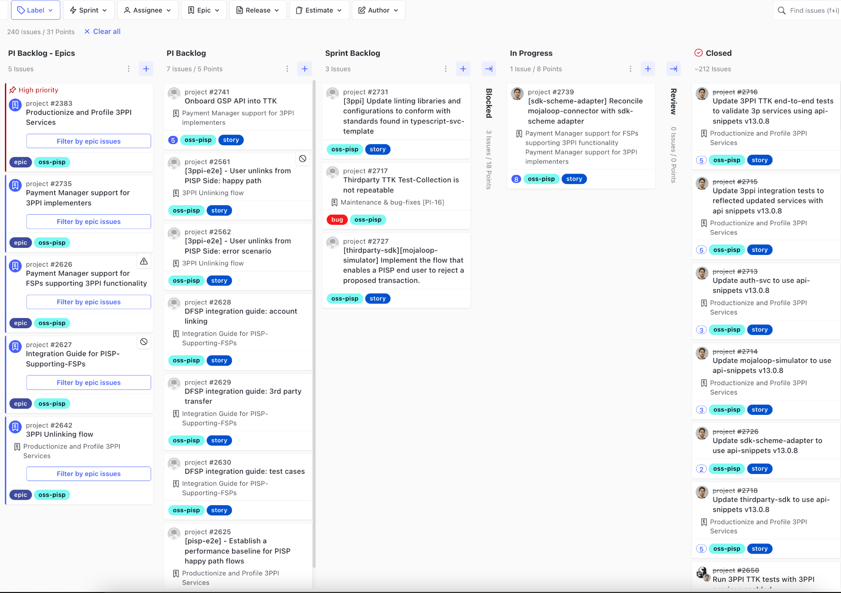
3P Workstream Progress
3PPI charts validated
3PPI TTK end-to-end tests validated
Bugs fixed
API discrepancies addressed
Prerequisites for 3PPI adapter development addressed
Development of adapters (or core connectors) for 3p functionality in progress

Slide 15
PI-18: 3p end-to-end tests video
https://youtu.be/Y4KluvHuSEM

Slide 16
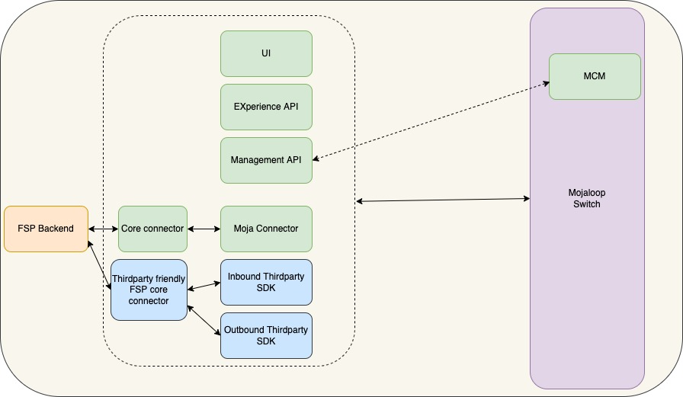
3PPI flows: FSP - PM - Mojaloop

Slide 17
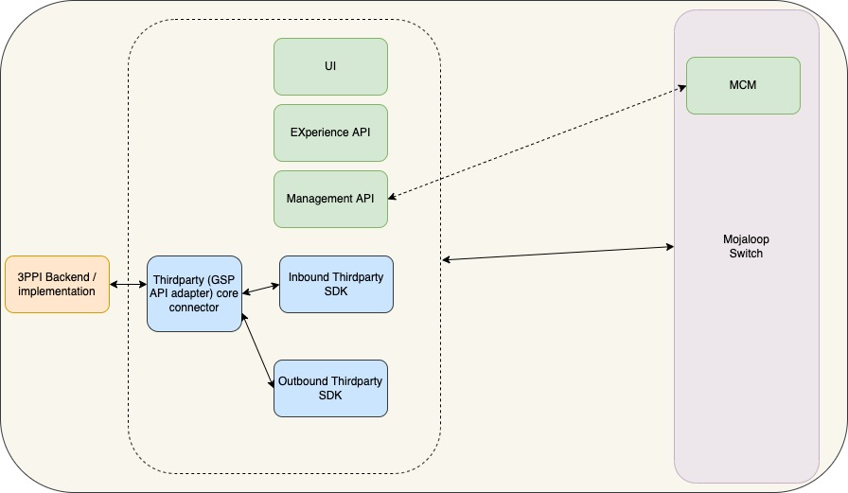
3PPI flows: 3PPI - PM - Mojaloop

Slide 18
API snippets update

Slide 19
What are API Snippets?
Reusable yaml definition code snippets & autogenerated Typescript interfaces
it is the set of basic Mojaloop Data Transfer Object Interfaces - YAML & Typescript
one source of truth - common type system
compact template definitions files for microservices
tooling for Typescript interfaces generation
Swagger UI online browser: https://mojaloop.github.io/api-snippets/
Notes:
Lewis

Slide 20
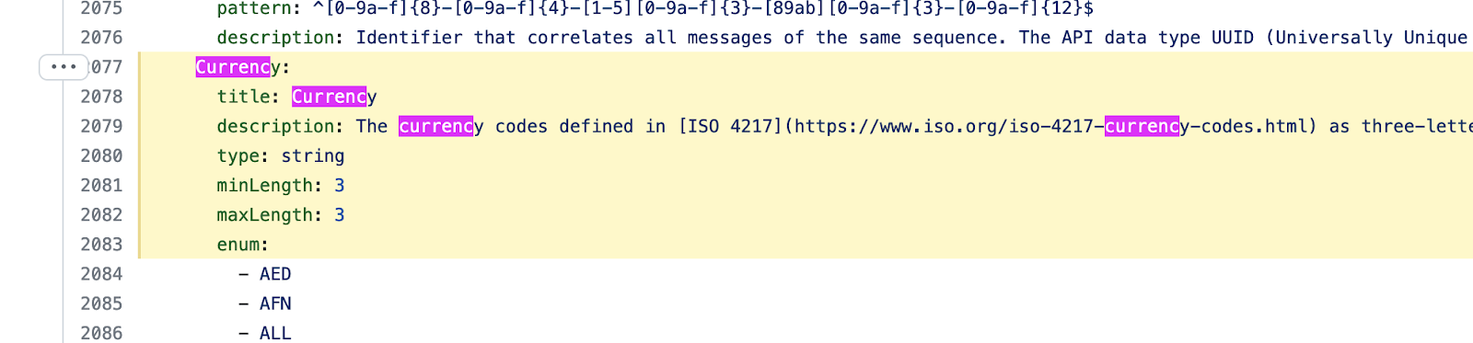
The Old Way
For example, if we wanted to add a new Currency code
Navigate to an existing specification: https://github.com/mojaloop/mojaloop-specification
Open a pull request and add a new Currency Code
Copy and paste in every service where we refer to Currency… at least 10 times. Hope you don’t make any mistakes in 1000’s of lines of Yaml specification
Code review 10+ times
Notes:
Lewis

Slide 21
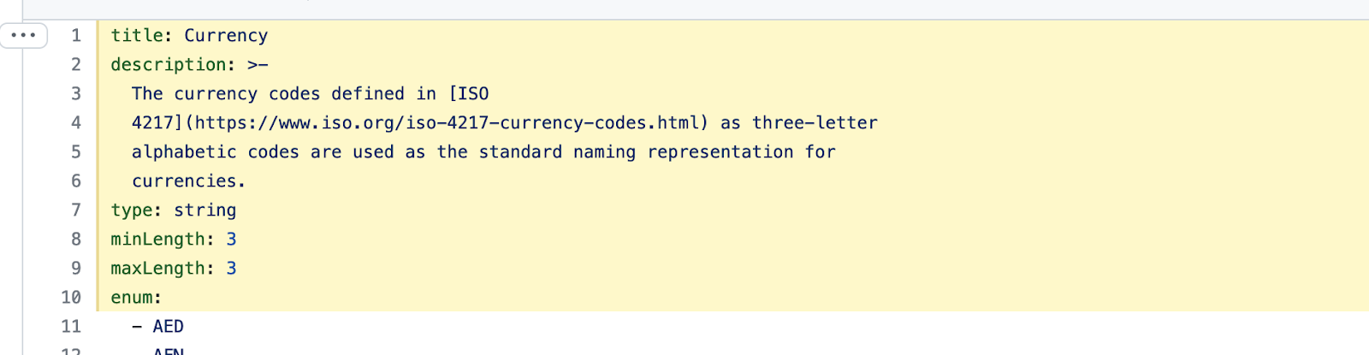

The New Way
For example, if we wanted to add a new Currency code
Navigate to the Currency.yaml definition in api-snippets
Pull Request + Code Review
A new version is built automatically (if we wish)
For each service, update the package.json to the latest api-snippets:
`npm install`
Notes:
Lewis

Slide 22
3PPI roadmap

Slide 23
PI-18 3PPI Goals [To be confirmed during roadmap planning]
Goal | Mojaloop 3PPI services adopted by 1 3PPI implementer & 1 FSP (in testing / QA)
Key Epics Objectives |  | Google Standard Payment API Adapter [Open Source] developed and released (PM included in 3p flows) |  | 2. DFSP Integration Guides (similar to https://sandbox.mojaloop.io/guides/overlay/g2p-3ppi-account-linking.html);
 |  | 3. Payment Manager support (3p friendly core connector) for DFSPs supporting 3PPIs |  | 5. Bonus: 1) 3P transaction request with ISO 20022. 2) Documentation: starter kits, extend use case support building on base functionality. 3) Documentation extensions: Business processes, list of responsibilities. 4) MTP course for 3PPI functionality
Not Doing now but important next & Risk / Issues |  | Future Roadmap: Spec changes to the GSP Adapter (will be retrofitted). |  | Risks / Issues: Dependency on Payment Manager, IaC (less on on IaC but PM) Dependency on 3PPI API changes to support an example 3PPI implementer To get this deployed live, we are dependent on implementers and DFSPs (their internal processes)
Success Defined How? |  | Stretch : Is there 1 implementer who has deployed the 3PPI Features, with 1 3PPI and 1 DFSP in test? If so, then we have been successful. |  | Minimum : End-to-end testing of 3PPI features with support for FSP, PISP instances, 3P services on the Hub and PISP services along with GSP adapter

Slide 24
Thank you!

